Slide 1
Custom Brushless Motor Controllers
01/19/2020| Adithya Subbiah

Slide 2
Agenda
Motivation
Current Status
Design
Components
Going Forward

Slide 3
Why make our own motor controllers?

Slide 4
Reduce cost
Goal is ~$50 per controller
Implement Field Orientated Control (FOC)
We can customize how much control we want
Learning new skills!
How freaking awesome is it to make your own brushless motor controller?!
Motivations

Slide 5
Current Status of the project

Slide 6
Most of the hardware has been made
It is still possible that there will be some hardware revisions
The bulk of the work is in software
We have trapezoidal control working and a position PID loop implemented
We still need to write sensorless and sensored FOC modes.
Current Status

Slide 7
Design

Slide 8
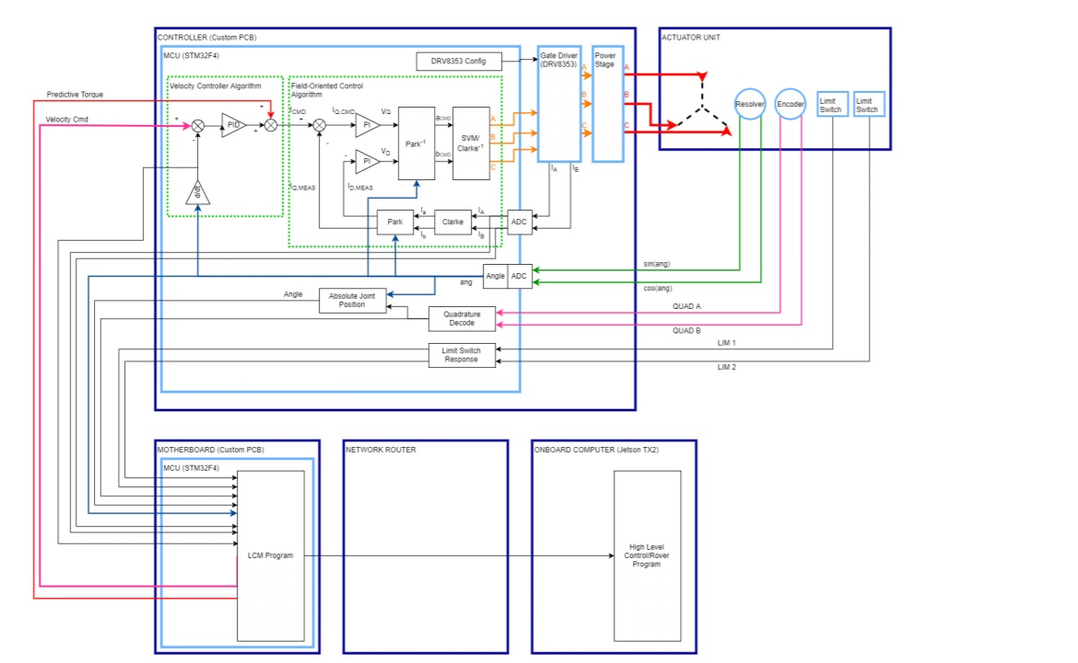
Design
This algorithm was never actually implemented, this instead is just a simple trapezoidal control scheme.

Slide 9
Components

Slide 10
Main processor:
STM32F303RE - ARM Cortex M4
This is where we do all of our PWM wave generation and local PID loops
Gate Driver:
Texas Instruments DRV8353RS
We send the PWM waves from the STM32 to this gate driver, this in turns turns on and off the gates
We also can receive current feedback from this gate driver
Components

Slide 11
Going Forward

Slide 12
Weekly meetings
I will send out a when to meet this week to nail a date and time
Join the Slack Channel!
# electrical-circ-motor-controllers
Feeling overwhelmed?
Don’t worry! It’s perfectly normal and at most of the meetings I will do a 20 min tech talk on a variety of topics (Brushless motors, Field Orientated Control, Embedded software, etc.)
Also, I will answer any question you have!
Going Forward

